Slide 1
Chapter 2: Bits and Bytes
Topics
Why bits?
Binary Logic
Representing information as bits
Binary/Hexadecimal
Byte representations
ints, floats, double precision

Slide 2
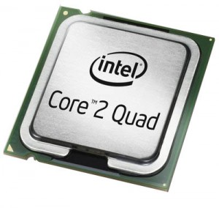
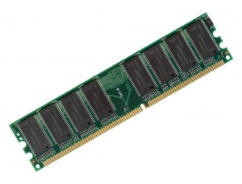
Recap: Systems In a Nutshell
add a,b
sub a,b
move a…
Lines of
Source
code
Pre-processor
&
Compiler
Lines of
Assembly
code
Assembler
&
Linker
Chapter 2
10101010
00001010
10101010
01010111
Lines of
Binary
code &
data
Memory
11101110
00111011
10000111

Slide 3
Decimal Representation
Decimal representation (Base 10) is what we humans naturally gravitate to, given 10 digits (fingers)!
7126 base 10 = 7126₁₀
= 7000 + 100 + 20 + 6
= 7*10³ + 1*10² + 2*10¹ + 6*10⁰
By convention, we write the most significant digit on the left, followed by the second most significant digit, then the 3rd most significant digit, etc., until we reach the least significant digit

Slide 4
Binary Representation – Why Bits?
0 1 0 1₂ = 0*2³ + 1*2² + 0*2¹ + 1*2⁰
= 0 + 4 + 0 + 1 = 5₁₀
Each binary digit is called a ‘bit’
Base 2 or Binary is easier to represent via electronic circuits than Base 10
Digital transistor circuits can easily represent a ‘0’ and a ‘1’
A ‘1’ = +5 volts, a ‘0’ = 0 volts, so only 2 voltage levels
Don’t have to implement 10 different voltage levels as in base 10
Easy to implement Base 2 arithmetic
much of Base 10 arithmetic using Base 2 arithmetic (integers are exact, but floats are approximations)
Easy to implement digital logic (AND, OR, etc.) with binary
Notes:
Most digital circuits today are based on CMOS (Complementary Metal Oxide Semiconductor) technology.
CMOS typically combines together NMOS and PMOS transistors to form digital logic and arithmetic circuits

Slide 5
Digital Logic via Boolean Algebra
Developed by George Boole in 19th Century
Algebraic representation of logic
Encode “True” as 1 and “False” as 0
And “&”
A&B = 1 only when both A=1 and B=1
B
A | B | &
0 | 0 | 0
1 | 0 | 0
0 | 1 | 0
1 | 1 | 1
A
Truth Tables
(two forms)
Notes:
Now we’re representing variables as TRUE/FALSE Booleans *and* performing *logical* operations on them. In the next subsections, we’ll consider representing variables as integers, and performing *arithmetic* operations on them. Note the above tables are called “truth tables”.

Slide 6
Common Digital Logic Operations
And “&”
A&B = 1 only when both A=1 and B=1
Or “|”
A|B = 1 when either A=1 or B=1
B
A
Not “~”
~A = 1 only when A=0
Exclusive-Or (Xor) “^”
A^B = 1 when either A=1 or B=1, but not both
Other operators: NAND (Not AND), NOR (Not OR), etc.
Notes:
Now we’re representing variables as TRUE/FALSE Booleans *and* performing *logical* operations on them. In the next subsections, we’ll consider representing variables as integers, and performing *arithmetic* operations on them. Note the above tables are called “truth tables”.

